Slide 1
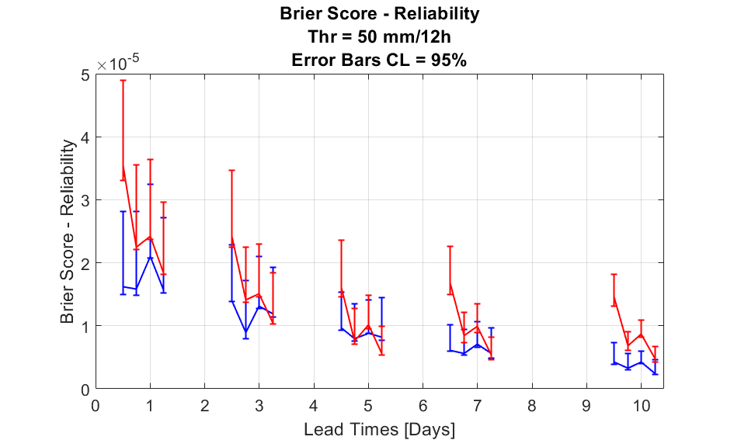
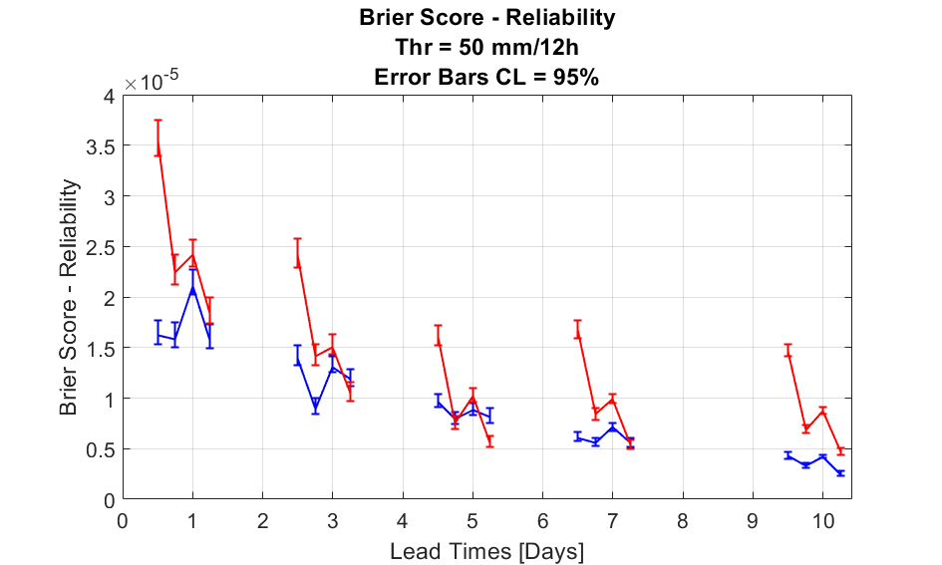
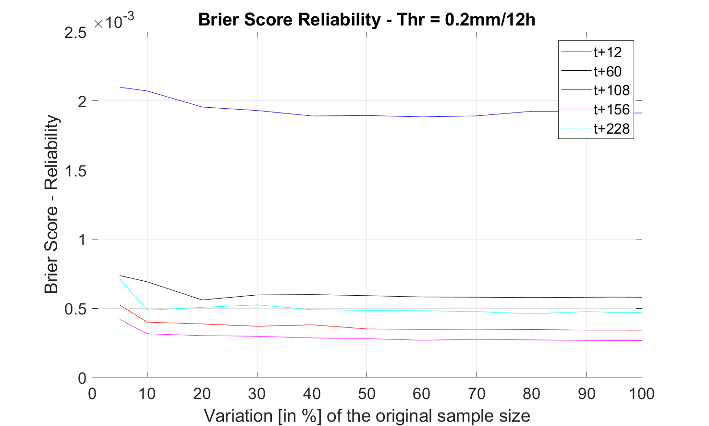
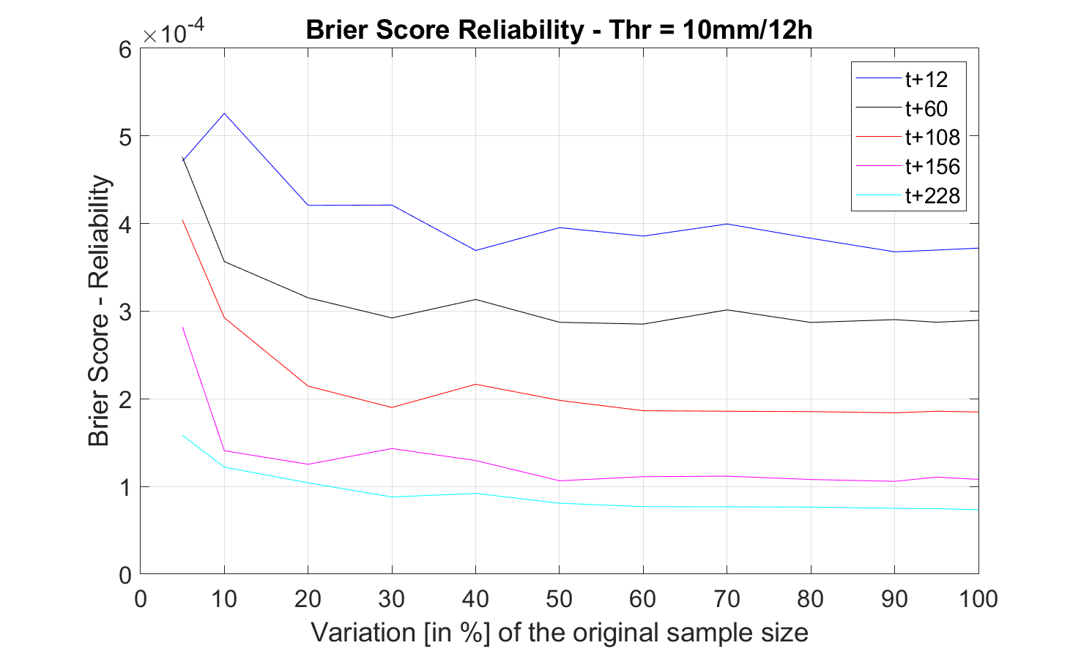
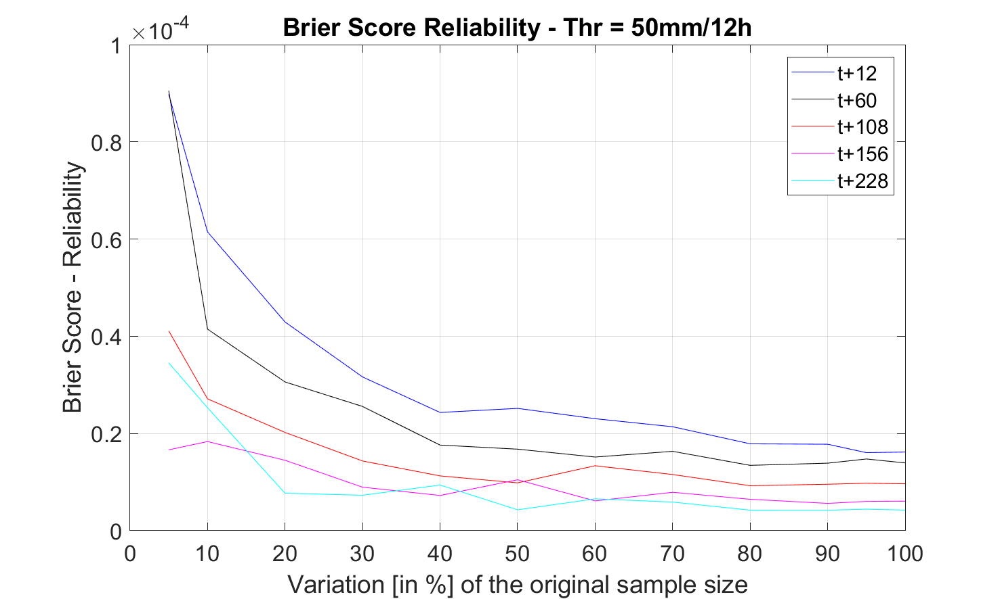
Creation of error bars
Bootstrapping with replacement
Creation of error bars
Bootstrapping with no replacement (95% original sample)
Variation of Brier Score Reliability with a Reduction of the Original Sample Size

